Slide 1
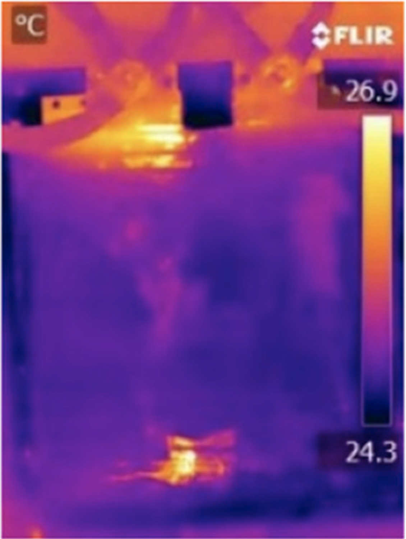
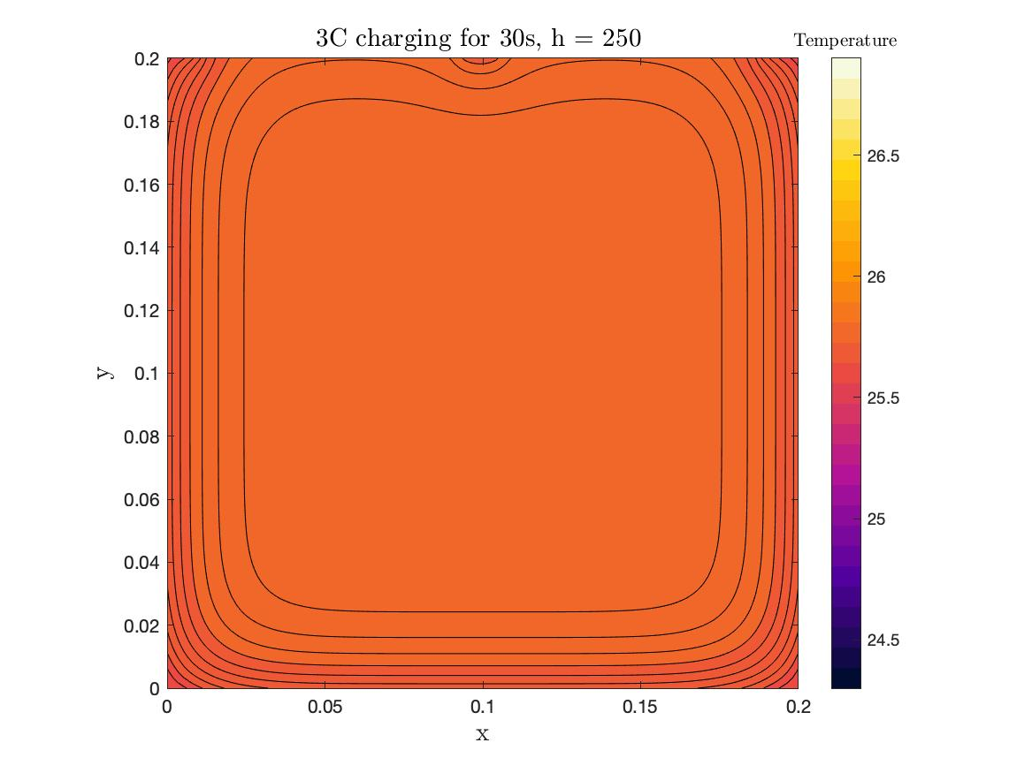

Slide 2
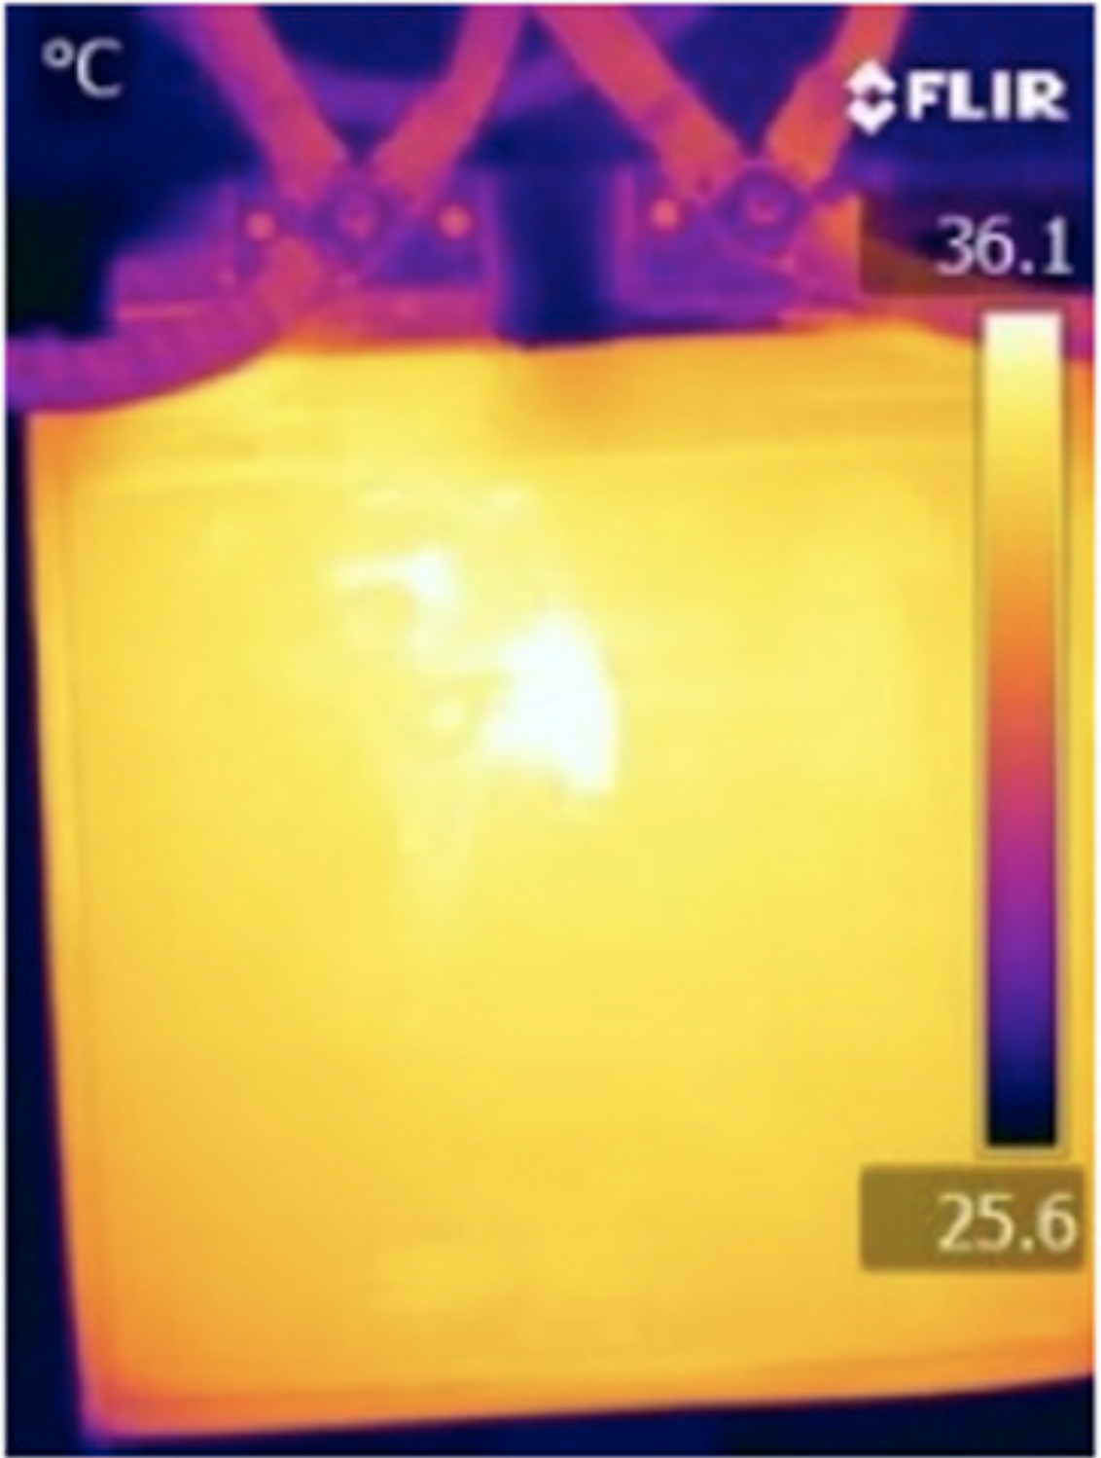
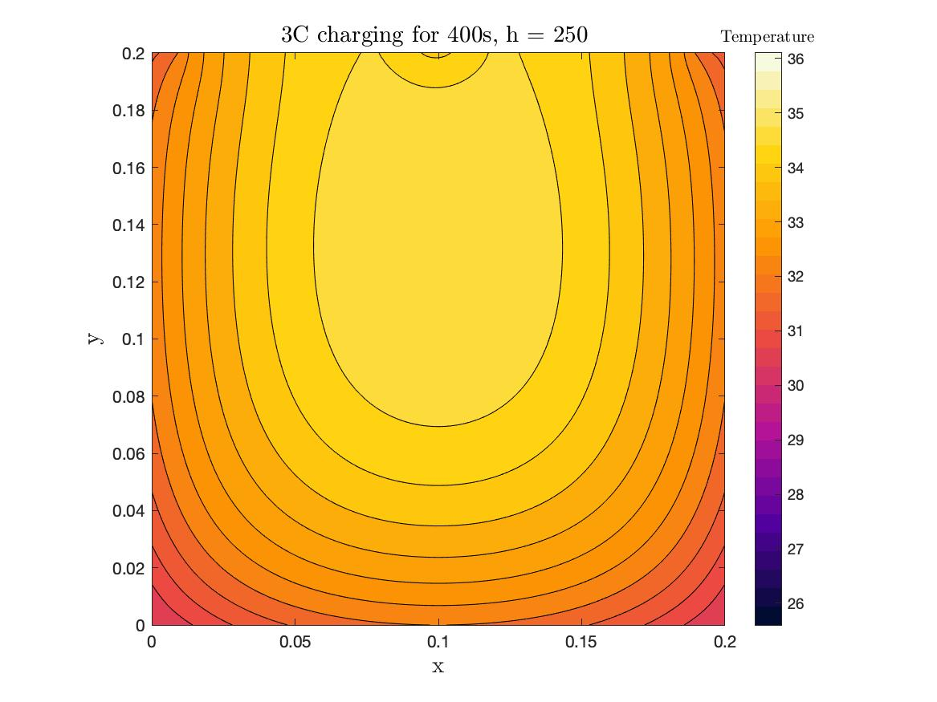

Slide 3
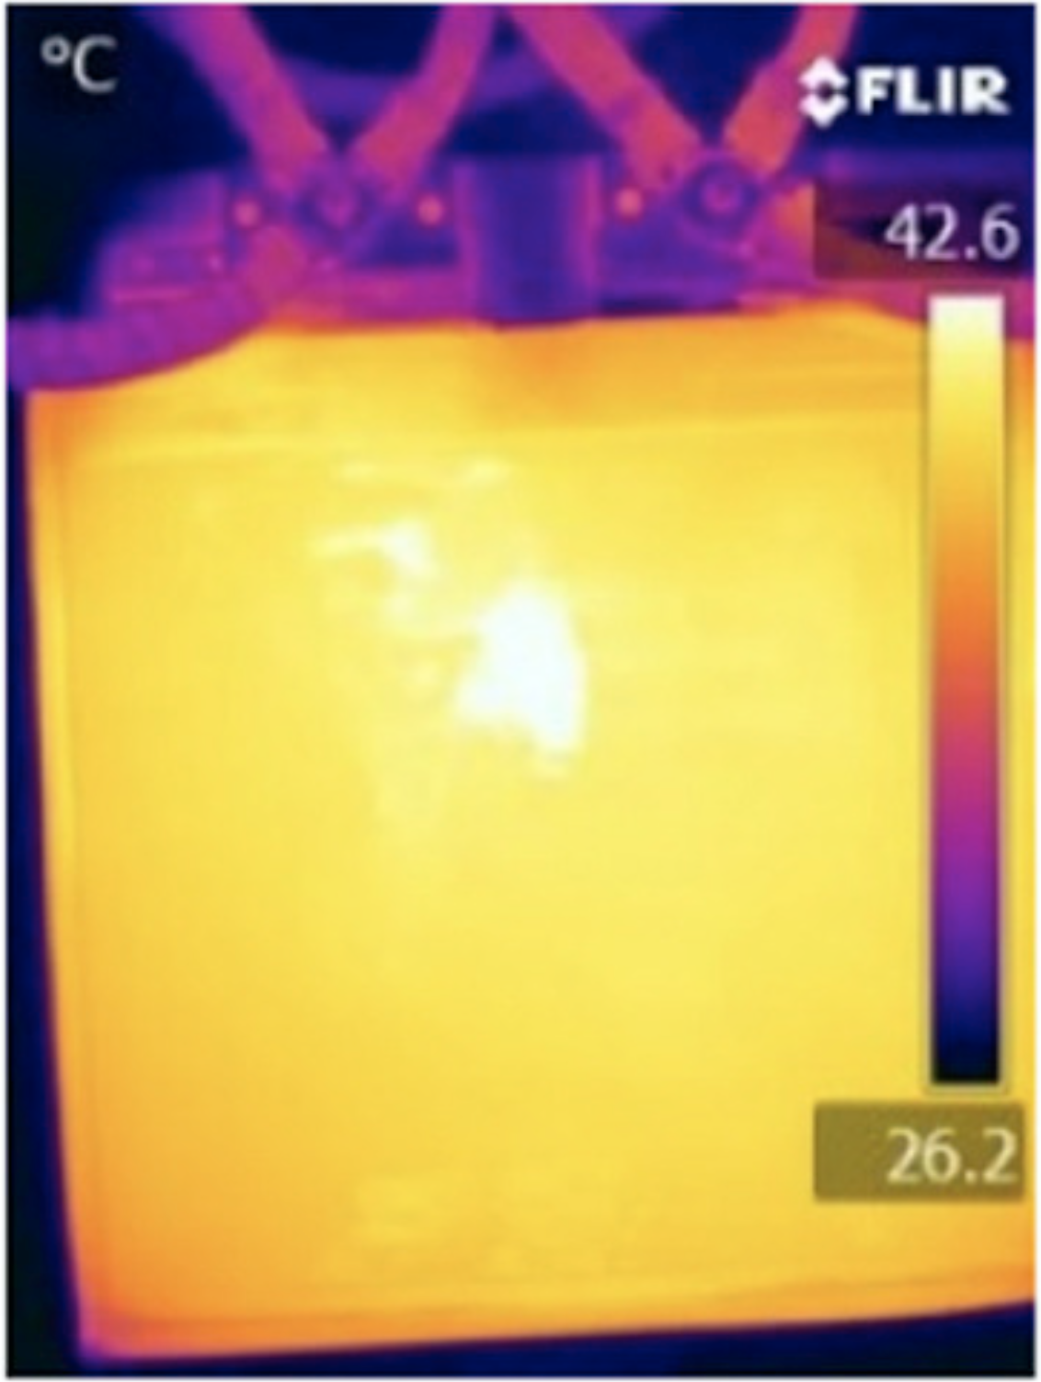
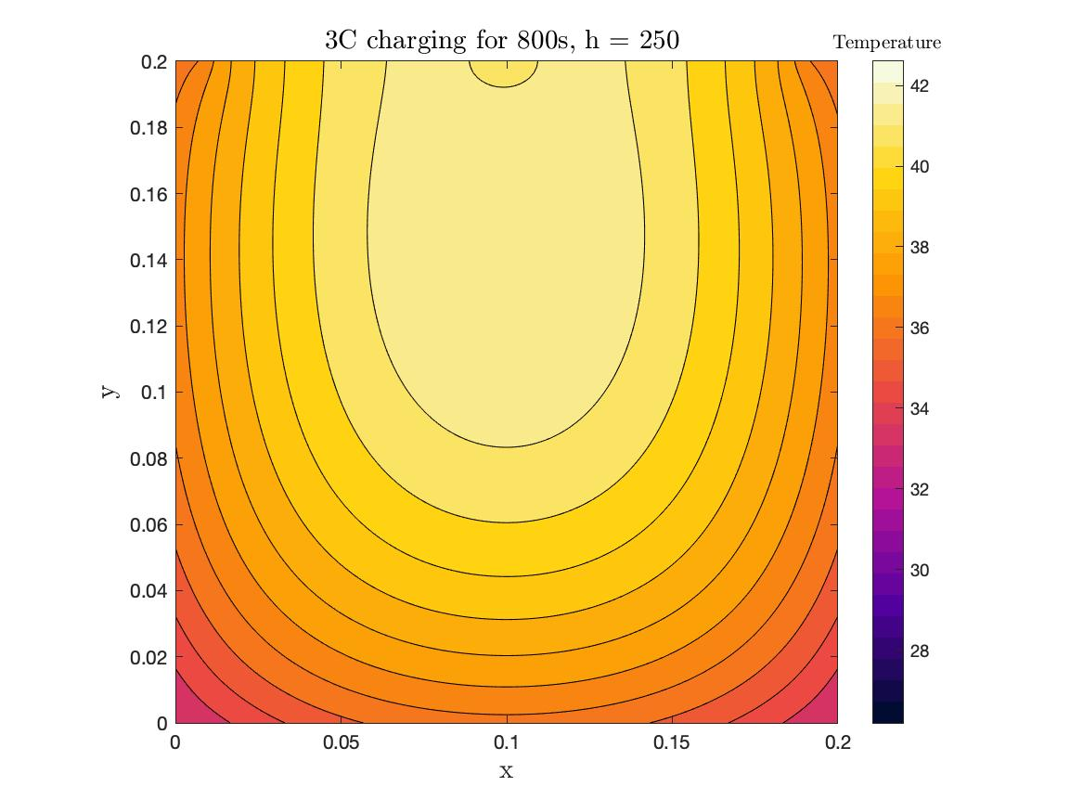

Slide 4
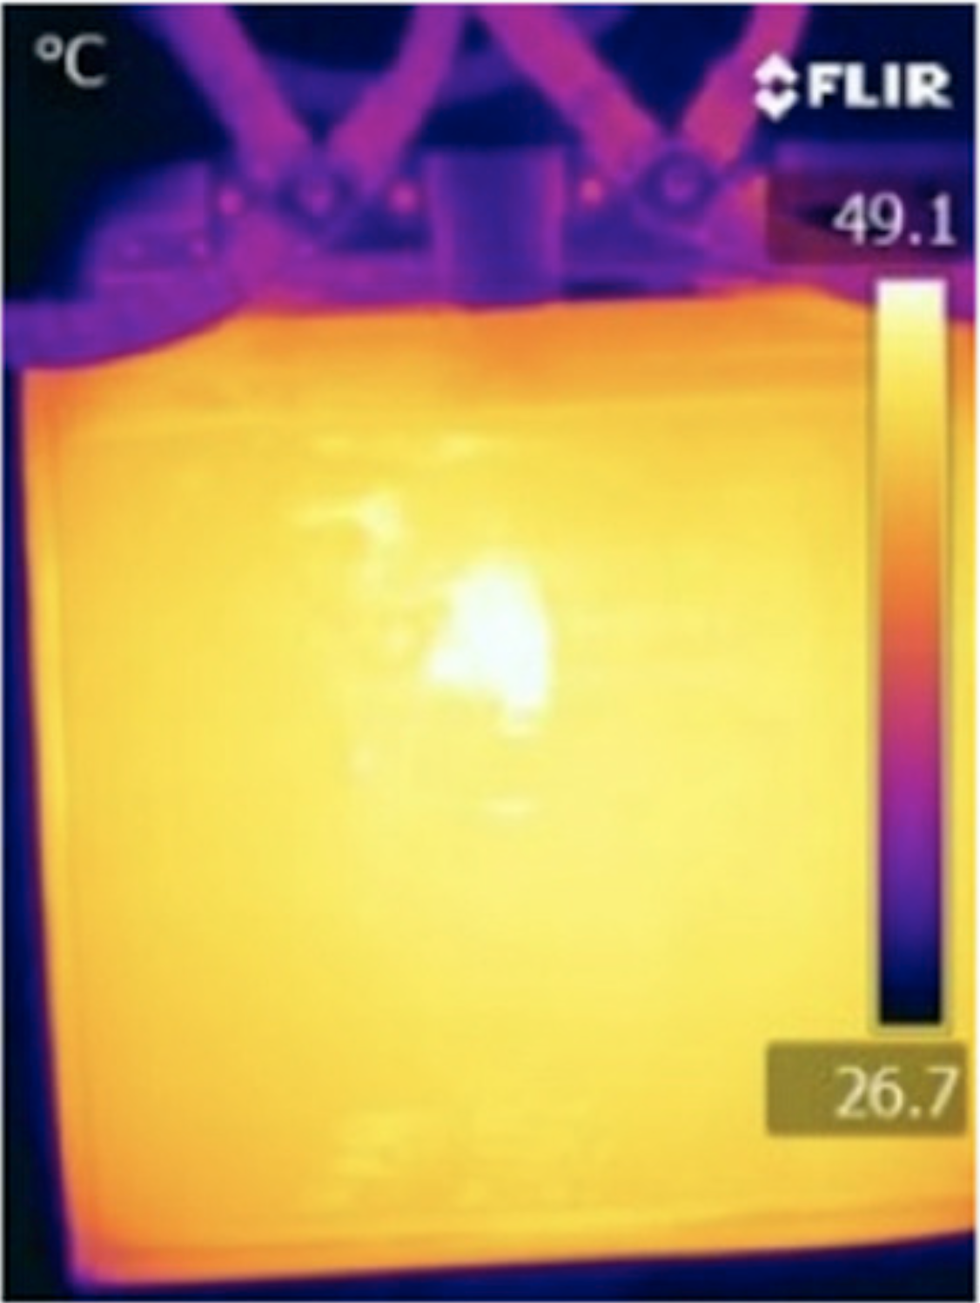

Slide 5
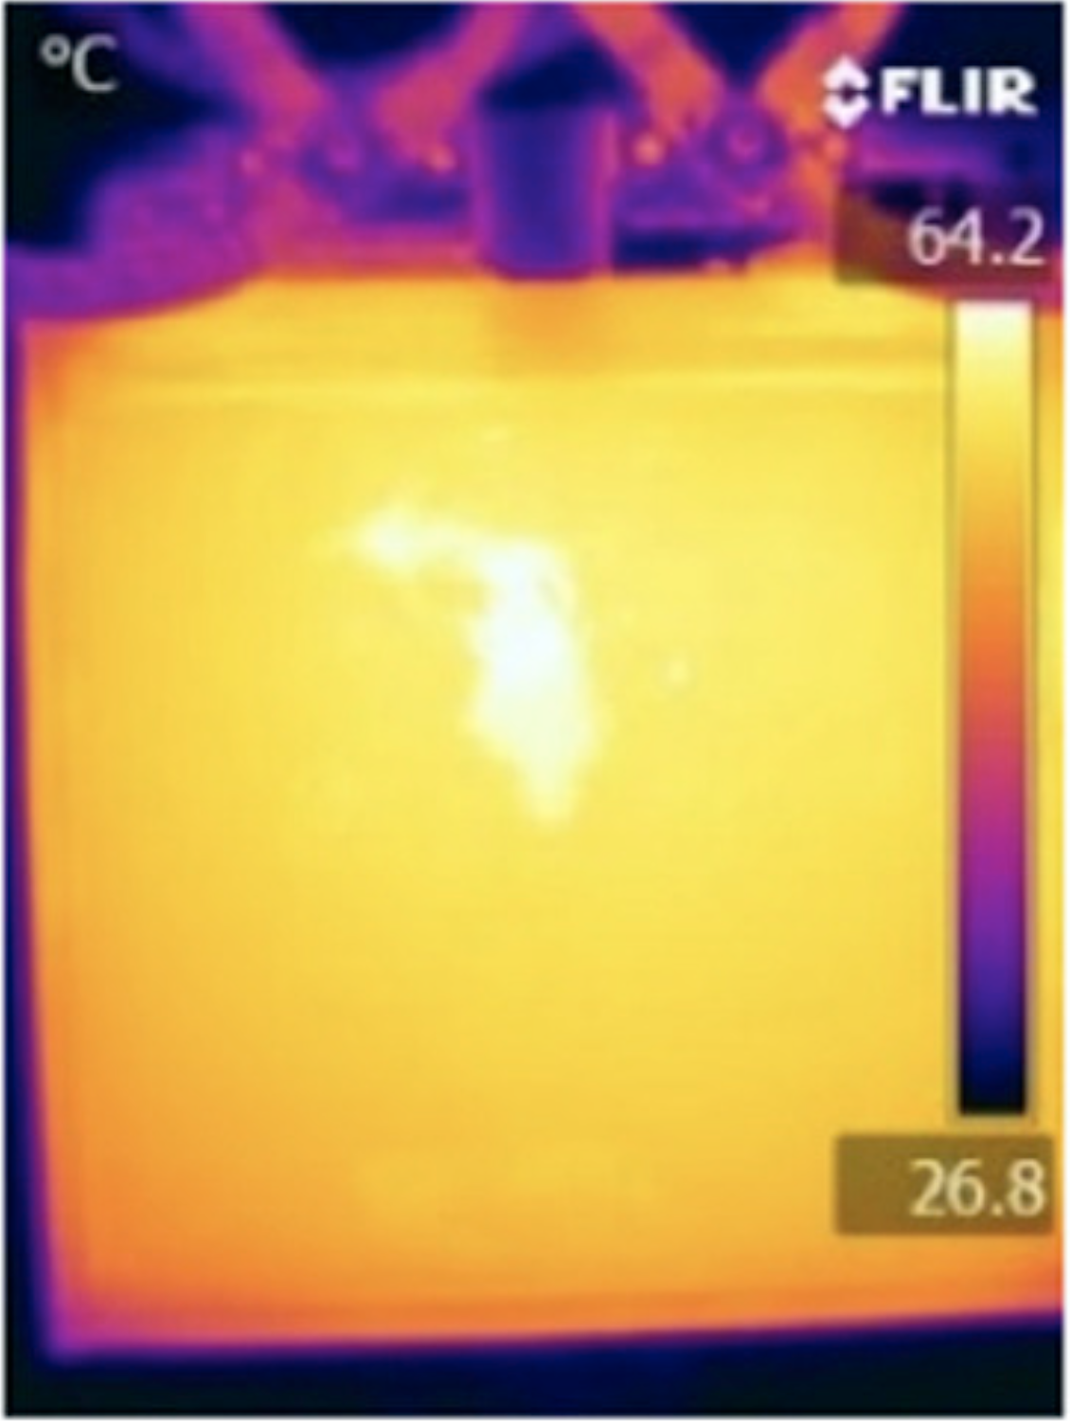

Slide 6
Heat in Negative Tab (Q_{tab-})
Heat in Positive Tab (Q_{tab+})
W_{tab}
W_{tab}
Heat out
(Q_{out})
Internal Heat Generation (Q_{gen})
H_{cell}
H_{act}
W_{act}
W_{cell}

